Slide 1
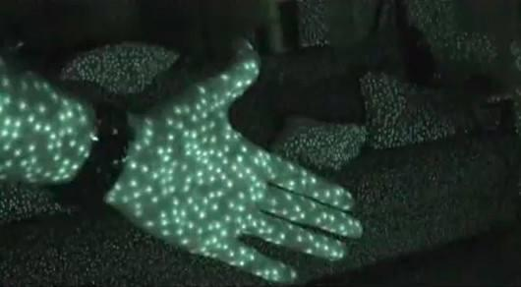
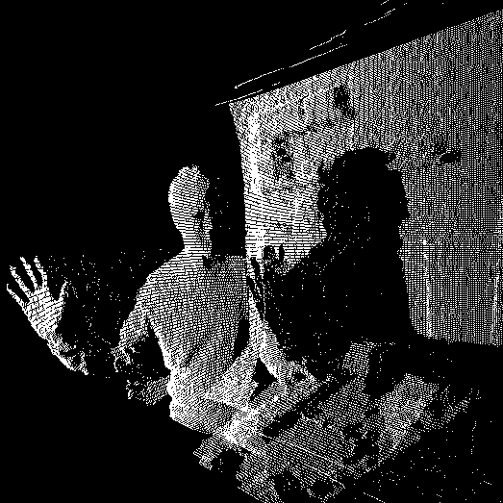
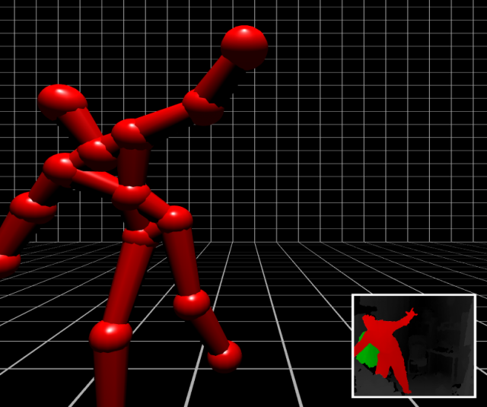
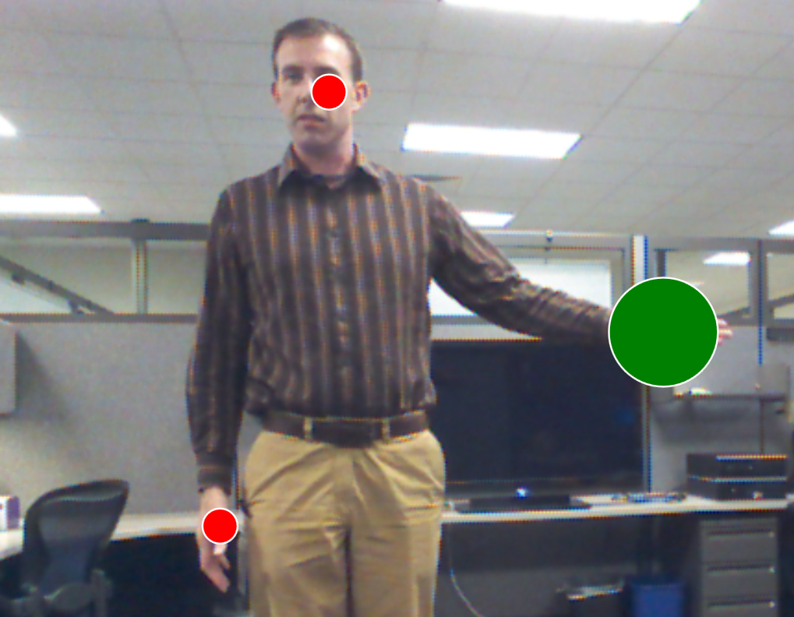
Kinect Technology

Slide 2
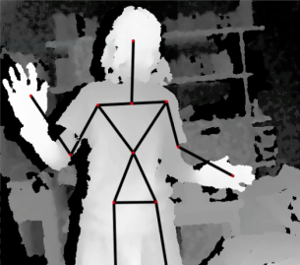

Kinect Software
Kinect for Windows SDK
Microsoft Speech Platform
Controls attached to key strokes for compatibility

Slide 3

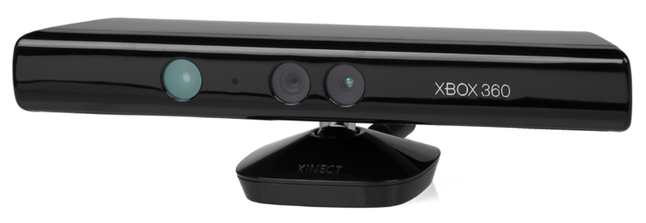
Gesture Controls
Forward: Wave motion using the right hand.
Back: Wave motion using the left hand.

Slide 4

Voice Controls
show next
show previous
open slideshow
close slideshow

Slide 5
Gesture Controls (Cont.)
Forward: Wave motion using the right hand.
Back: Wave motion using the left hand.
Zoom: Diagonal swipe using both hands.

Slide 6
Voice Controls (Cont.)
show next
show previous
zoom in
zoom out

Slide 7
Breakthroughs
Everything Can be Locked Down
Multiple Presenters
Switching Between Presenters
Cost effective technology
Wow Factor

Slide 8
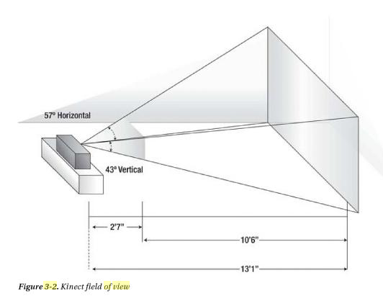
Drawbacks
Presenter must watch being overly animated
Presentations can be hijacked
Microsoft recommended visual range is 4 to 12.5 feet and pyramid in shape

Slide 9

Future Thinking
What Other Uses Are There For The Technology and Other Questions?

Slide 10
Play Time
An Opportunity to Interact
with the Presentation

Slide 11

Thank You

